Slide 1






Font Size
Font Family
Audio
Summarize
LumaText
Your Personalized Reading Companion
Zainab Sajjad & Merril Biju
Notes:
Hi, I'm Zainab —
And I'm Merril!
Welcome to our project: LumaText!
We created LumaText because we believe everyone deserves equal access to clear, understandable information — no matter their learning style or ability. Inspired by the need for greater educational equity, we designed LumaText to make reading, writing, and understanding easier and more inclusive for all.

Slide 2



Font Size
Font Family
Audio
Summarize
PITCH
LumaText is an AI-powered web app that makes reading, writing, and understanding text easier, especially for people with disabilities like dyslexia. Built on the belief that everyone deserves access to clear information, LumaText lets users upload PDFs or text files, instantly extract the text, and get simplified summaries.
It also features text-to-speech, customizable fonts, dark mode, and microphone-based note-taking, creating a flexible, accessible, and inclusive reading experience.
Notes:
LumaText is an AI-powered web application designed to make reading, writing, and understanding text easier, especially for individuals with disabilities like dyslexia. We believe everyone deserves access to clear and understandable information. With LumaText, users can easily upload PDFs or text files and instantly extract the text inside. AI then summarizes long and overwhelming documents into simple, easy-to-digest versions, helping users focus on the most important ideas without getting lost in complicated wording. For users who prefer listening over reading, LumaText also offers full text-to-speech functionality, reading both the uploaded content and summaries aloud at the click of a button. Users can adjust font size and font style to suit their needs, and a built-in dark mode provides a comfortable viewing experience for different lighting and sensory preferences. For those who find it easier to speak than type, it also offers a microphone note-taking feature, turning speech into written notes automatically. LumaText combines powerful AI with thoughtful design to create a reading experience that is flexible, supportive, and truly inclusive.

Slide 3

Font Family
Font Size
Font Family
Font Size
Audio
Audio
Summarize
Summarize
Introducing: LumaText AI
LumaText AI: A Multifaceted Approach
A web-based tool for more accessible, clear, and efficient reading
Key integrated features:
Dynamic Font Control (Size & Family)
Editable Text Areas (Uploaded, Summary, Voice Notes)
AI-Powered Summarization
Text-to-Speech Functionality
Speech-to-Text Capability
Dark/Light Mode Option
Versatile File Upload (.txt, .pdf)
Notes:
Merril
LumaText AI is a web-based tool designed to make reading more accessible, clear, and efficient for all users. It offers dynamic font control, allowing users to adjust text size and style for their comfort, along with editable text areas for uploaded files, AI-generated summaries, and voice notes. Powered by advanced AI, LumaText can quickly summarize long documents, making complex information easier to digest. It also includes full text-to-speech functionality for users who prefer listening, and speech-to-text capabilities for easy voice note-taking. With a dark/light mode option and support for versatile file uploads like .txt and .pdf, LumaText AI creates a flexible and inclusive reading experience tailored to individual needs.

Slide 4
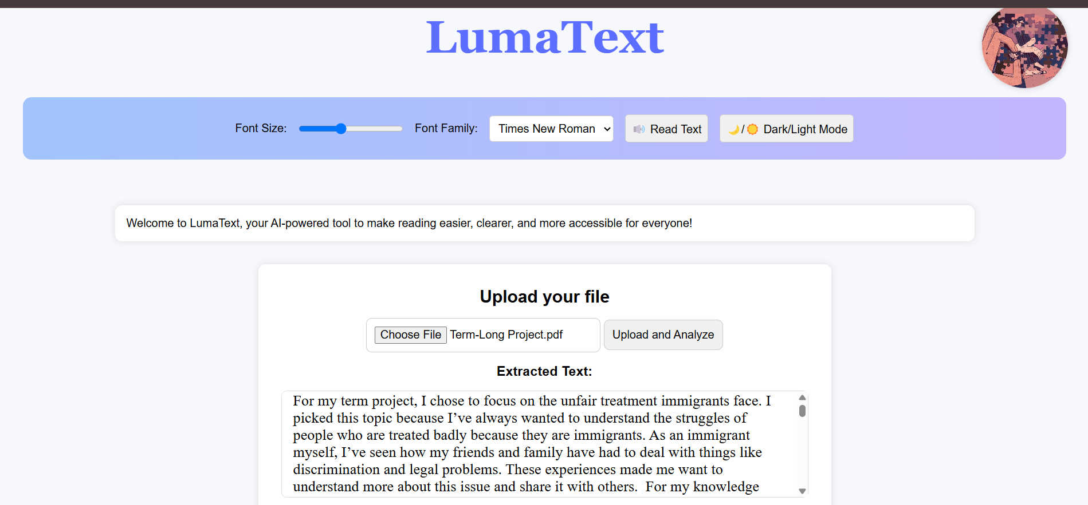
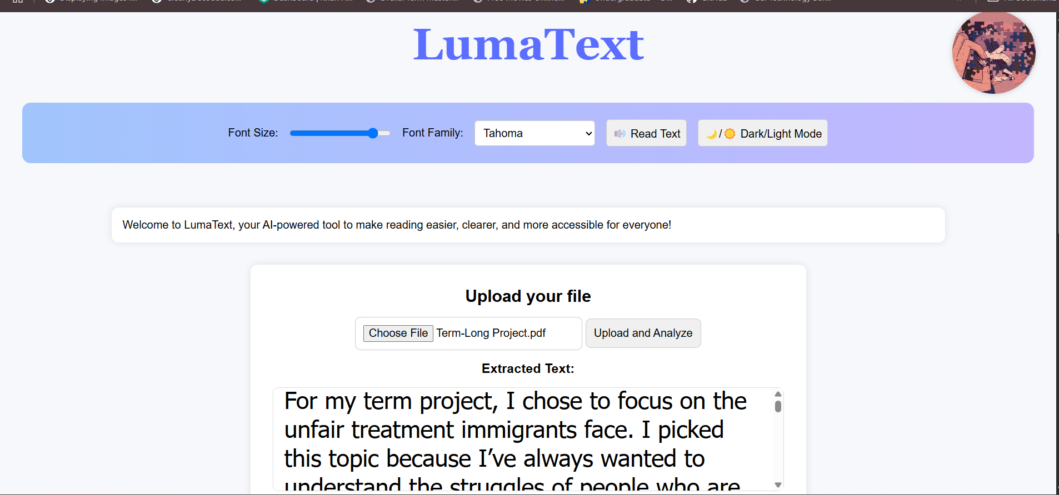

Font Size
Font Family
Audio
Summarize
Personalized Reading Experience
Adjustable Font Size: Easily modify text size for optimal viewing
Selectable Font Family: Choose from accessible fonts (Arial, Verdana, Tahoma, Times New Roman)

Slide 5
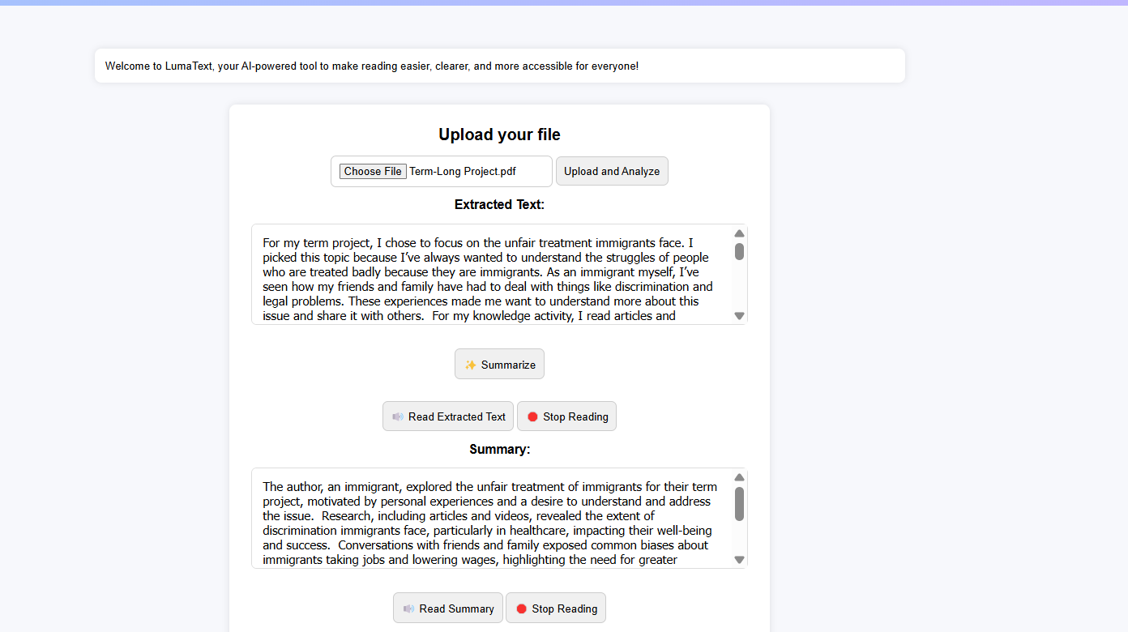
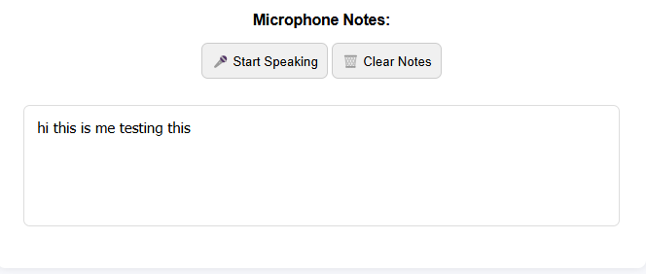
Font Size
Font Family
Audio
Summarize
Key Features: Engaging with Text and Leveraging AI
Editable Text Areas: Direct modification for corrections, annotations, and personalization
AI-Powered Summarization (Gemini): Quick, concise summaries of uploaded content
Text-to-Speech: Listen to any text within the tool for enhanced understanding
Speech-to-Text: Voice input transcribed into editable "Microphone Notes."

Slide 6


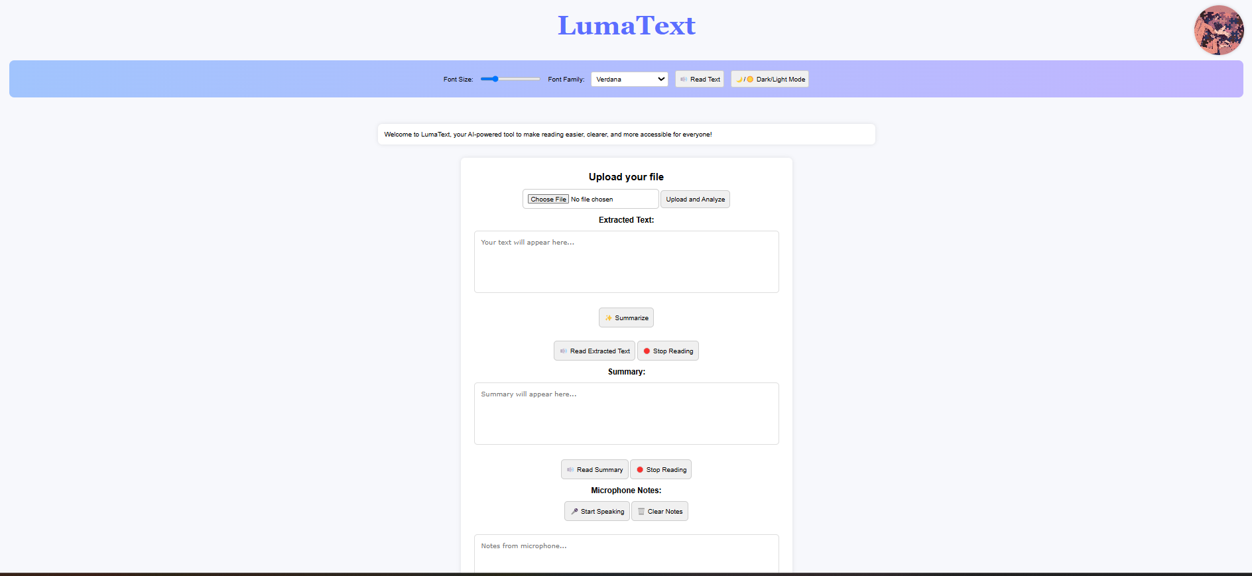
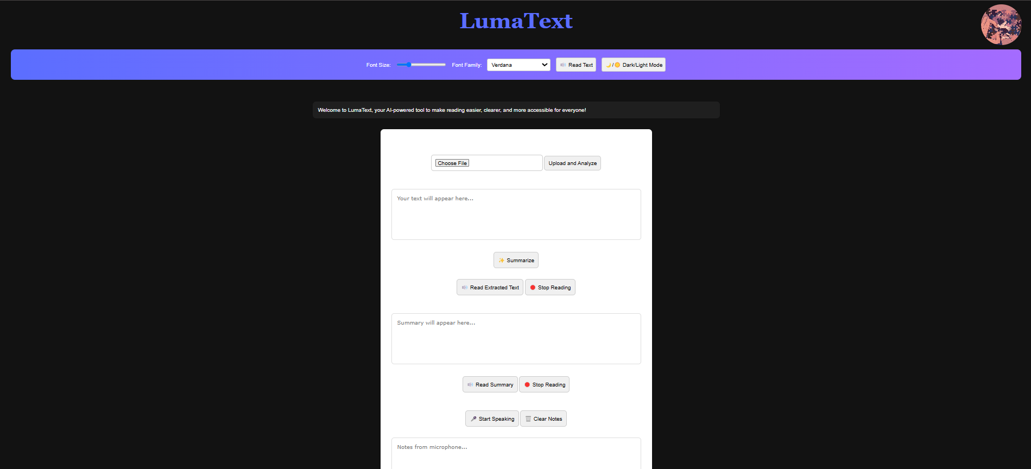
Font Size
Font Family
Audio
Summarize
Visual Showcase
This image on our website represents LumaText AI's supportive role, like a helping hand guiding users to easily process and understand text.
Notes:
So as for our visual showcase, as u can see we have a dark mode and light mode. And we also wanted to touch on our logo as u can see in the middle, it represents

